Slide 1
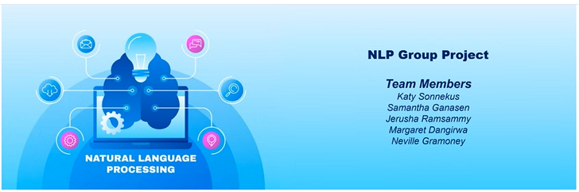
2409PTDS Classification Project
Team Members
Katy Sonnekus, Jerusha Ramsammy, Maragaret Dangirwa,
Neville Gramoney, Samantha Ganasen
This project focuses on building a robust machine learning pipeline to classify news articles into predefined categories. It encompasses the full lifecycle from data preprocessing to model deployment in a Streamlit application.

Slide 2
Table of Contents
Project Objective and Scope of Work
Dataset & Preprocessing
Model Development
Streamlit App
GitHub & Environment Setup
Project Management Tools
Conclusion

Slide 3











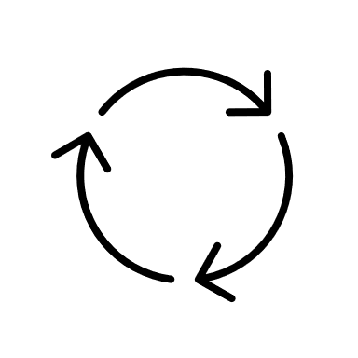







1. Project Objective and Scope of Work
Objective
The goal is to develop a classification model that can accurately categorize news articles into domains such as Business, Technology, Sports, Education, and Entertainment. The final model is deployed in a user-friendly Streamlit app, allowing real-time predictions on new articles.
Scope of Work
Categorise articles into 5 domains
Business
Technology
Sports
Education
Entertainment
Evaluation
Evaluate performance using precision, recall, and F1-score.
Workflow
Data Loading and Preprocessing
Deployment
Build a Streamlit web application to allow users to input articles and receive category predictions. Host the app online to demonstrate real-world utility.
Model Training
Train multiple models:
Logistic Regression
Multinominal Naive Bayes
Random Forest
K-Nearest Neighbors

Slide 4
2. Dataset & Preprocessing
Dataset:
Training Dataset (train.csv) is rich in business and economic news, covering a wide range of topics:
Regulatory & Policy Updates RBI revised KYC norms for politically-exposed persons. Government issued advisories on AI-generated deepfakes. Import restrictions were placed on laptops and PCs to boost domestic manufacturing.
Corporate & Market Performance LIC and NDTV reported contrasting quarterly results. IPOs like Netweb Technologies and market movements in Sensex/Nifty were tracked. Adani Green and TotalEnergies formed a renewable energy joint venture.
Economic Indicators India’s current account deficit dropped to 1% of GDP. Borrowing costs for states hit a fiscal high. The rupee hit an all-time low against the US dollar.
Strategic Business Moves Air India’s fleet expansion with A350 aircraft. ITC’s focus on FMCG growth. UIDAI appointed a new chairperson.
Global & Trade Context India’s exports and imports declined, widening the trade deficit. Electricity demand for air conditioning is projected to rise 9x by 2050.
Test Dataset (test.csv) spans multiple domains—business, sports, education, technology, and entertainment:
Business GST Council decisions on tax exemptions and rate changes. Toyota’s adoption of Tesla-style gigacasting. Nayara Energy’s export drop due to domestic demand. OYO launched a premium brand “Palette”.
Sports Cristiano Ronaldo’s debut for Al Nassr. Rafael Nadal’s injury update. Controversies in women’s boxing and hockey. David Warner ruled out of India Tests.
Education Updates on NEET, EAMCET, IGNOU, and FMGE. UGC launched a WhatsApp channel for real-time updates. Approval of 50 new medical colleges.
Technology WhatsApp added HD photo sharing and video controls. Meta explored monetization strategies. Apple Watch faced a potential ban. ISRO’s Aditya L1 mission reached the Lagrange point.
Entertainment Tanuja’s hospitalization and Ira Khan’s unique wedding. Karan Johar and Shahid Kapoor made headlines. Salaar vs Dunki box office rivalry.
What These Datasets Tell Us
Train Dataset is focused on structured, finance-heavy content, ideal for training a model to classify business and economic news. Test Dataset is broader and more diverse, useful for evaluating how well a model generalizes across multiple domains. Together, they provide a robust foundation for building and testing a news classification model that can handle both domain-specific and general news content.

Slide 5
2. Dataset & Preprocessing
Training Dataset is heavily focused on business and economic news, offering a rich variety of topics:
Regulatory & Policy Updates: Covers changes in KYC norms, AI deepfake advisories, and import restrictions to support domestic manufacturing.
Corporate & Market Performance: Tracks quarterly results, IPO activity, and strategic partnerships like Adani Green with TotalEnergies.
Economic Indicators: Highlights macroeconomic trends such as the current account deficit, borrowing costs, and currency performance.
Strategic Business Moves: Includes corporate developments like Air India’s fleet expansion and leadership changes at UIDAI.
Global & Trade Context: Reflects international trade dynamics and long-term projections like rising electricity demand for cooling.
Test Dataset spans a diverse range of domains, offering a broad evaluation base for the classification model:
Business: Covers policy changes (e.g., GST exemptions), corporate strategies (e.g., Toyota’s gigacasting), and market shifts (e.g., OYO’s new brand launch).
Sports: Includes high-profile athlete updates (Cristiano Ronaldo, Rafael Nadal), controversies, and team changes.
Education: Features exam updates (NEET, EAMCET), institutional developments (new medical colleges), and digital communication initiatives by UGC.
Technology: Highlights product updates (WhatsApp, Apple Watch), platform strategies (Meta), and space achievements (ISRO’s Aditya L1).
Entertainment: Reports on celebrity news, health updates, weddings, and box office rivalries.
What These Datasets Tell Us
Train Dataset is focused on structured, finance-heavy content, ideal for training a model to classify business and economic news. Test Dataset is broader and more diverse, useful for evaluating how well a model generalizes across multiple domains. Together, they provide a robust foundation for building and testing a news classification model that can handle both domain-specific and general news content.

Slide 6
3. Dataset & Preprocessing
Preprocessing in the context of text classification are the steps taken to clean and prepare raw text data before feeding it into a machine learning model. These steps help reduce noise, standardize the format, and improve the quality of features extracted from the text. These included:
Lowercasing: Converts all text to lowercase to ensure uniformity (e.g., "India" and "india" are treated the same).
Removing Punctuation and Special Characters: Cleans out symbols like !, @, #, etc
Removing Stopwords: Eliminates common words like "the", "is", "and", which occur frequently but add little value for classification.
Tokenization: Splits text into individual words or tokens (e.g., "India wins match" → ["India", "wins", "match"]).
Lemmatization/Stemming: Reduces words to their base or root form (e.g., "running" → "run").
Whitespace Normalization: Removes extra spaces and ensures consistent spacing between words.
Invalid urls
Check and fix data types
Length filtering
Category Standardization:
Business: economy, market
Sports: cricket, football, tennis
Technology: tech, AI, privacy
Education: admissions, scholarships, policy
Entertainment: Bollywood, Hollywood, cinema
This mapping ensures a cleaner label space and enhances model generalization.
These insights helped validate the relevance of features and guide model expectations
.

Slide 7
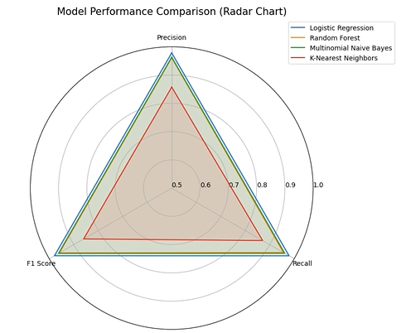
4. Model Development
Models Implemented:
Logistic Regression: A linear model used for binary and multi-class classification.
Naive Bayes: Probabilistic classifier based on Bayes’ theorem, effective for text classification.
Random Forest: Ensemble method using decision trees, robust to overfitting.
K-Nearest Neighbors (KNN): Instance-based learning method that classifies based on proximity to training samples.
Why These Models?
Diverse approaches to classification
Balance between interpretability and performance
Suitable for text-based data
Evaluation Metrics:
Accuracy
Precision, Recall, F1-score
Confusion Matrix
Training Strategy: Train each model
Predict on validation data
Display confusion matrix
Print classification report
Visuals:
Confusion matrices for each model
Radar chart comparing model performance across metrics
Insights:
Helps identify the best-performing model
Balances between precision and recall depending on use-case

Slide 8
5. Streamlit App
The Streamlit app serves as the final deployment layer of the project, allowing us to interact with the trained model by inputting news articles and receiving real-time category predictions. This bridges the gap between model development and real-world usability.
Key Features of the Streamlit App
The app includes predictions from different models allowing us to compare outputs and understand model behavior.
We were able to enter article text directly into the app and receive instant predictions.
The app is structured into multiple sections:
Category prediction
Confidence scores
Word Cloud
User-Friendly Design - The interface is clean, intuitive, and accessible to both technical and non-technical users, making it suitable for public deployment.
Value Adds
Demonstrates the model’s real-world applicability.
Encourages user engagement and feedback.
Supports decision-making by providing instant insights from news content.

Slide 9
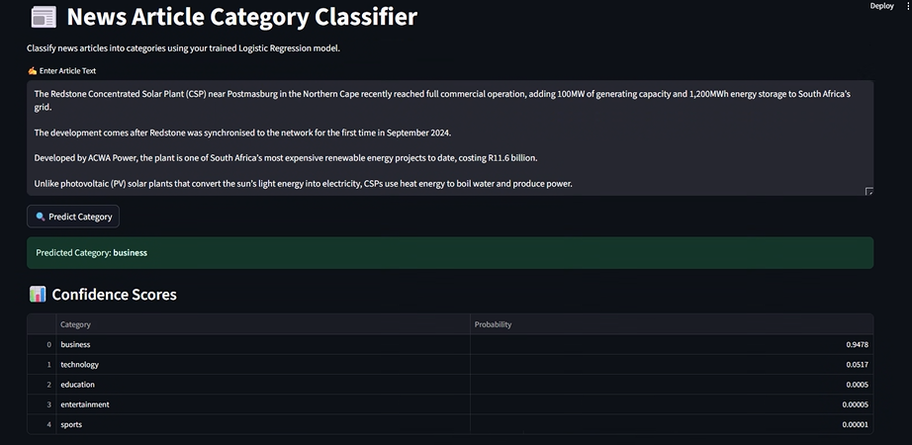
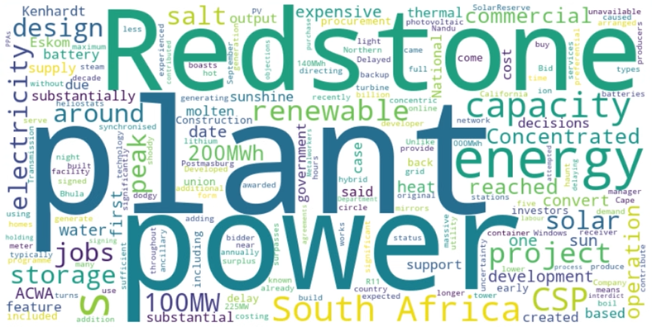
6. Streamlit App

Slide 10
7. GitHub & Environment Setup
Repository Setup:
Private repo with collaborators
Updated README
requirements.txt for environment recreation
Environment Creation:
Using Conda and pip
8. Project Management Tools
Trello Board: For task tracking
Jupyter Notebook: For development
Helpful Links: Streamlit, Markdown cheatsheet

Slide 11
8. Conclusion
This classification project successfully demonstrated the end-to-end development of a machine learning solution for categorizing news articles across multiple domains. Through data preprocessing, and model evaluation, we built a system capable of understanding and classifying textual content with meaningful accuracy. The integration of a Streamlit application further showcased the model’s real-world applicability, enabling interactive predictions and user engagement.
Despite facing challenges such as restricted access to deployment tools on corporate devices and computational limitations, the project highlighted the importance of adaptability, collaboration, and iterative learning.
Overall, this project not only strengthened our technical proficiency in natural language processing and machine learning but also emphasized the value of translating data-driven insights into accessible, user-friendly applications.

Slide 12
Thank you

